Slide 1
How I saved 80% on my Azure Data Factory Costs
Koen Verbeeck – He/him

Slide 2





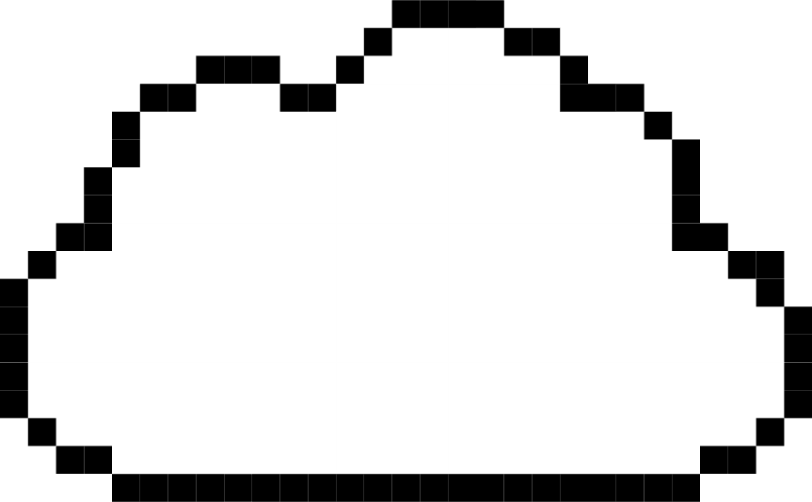
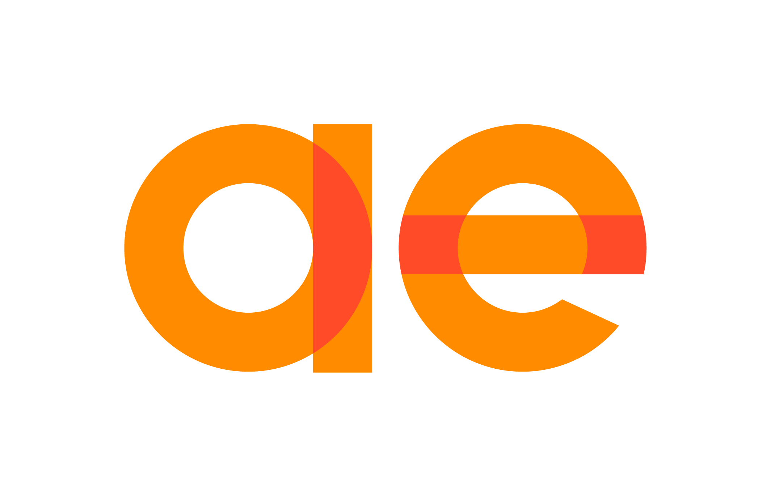
Contact
Koen Verbeeck
@Ko_Ver
@koenv.bsky.social
SQLkover.com

Slide 3
Outline
01
What is ADF?
02
ADF vs SSIS
03
How to save on costs
04
What about Fabric?

Slide 4

Quick Poll

Slide 5
What is ADF?

Slide 6
A fully managed, serverless data integration service. Visually integrate data sources with more than 90 built-in connectors at no added cost. Easily construct ETL and ELT processes code-free in an intuitive environment or write your own code.

Slide 7
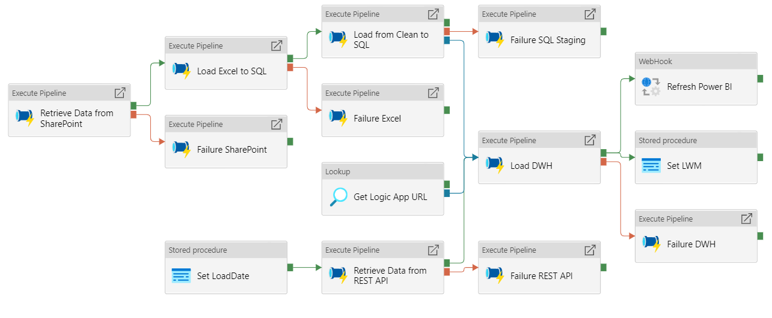
Basically a cloud ELT orchestrator

Slide 8
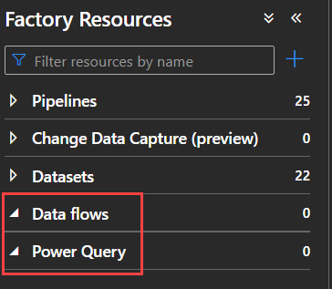
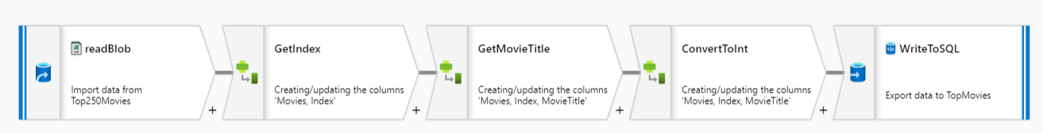
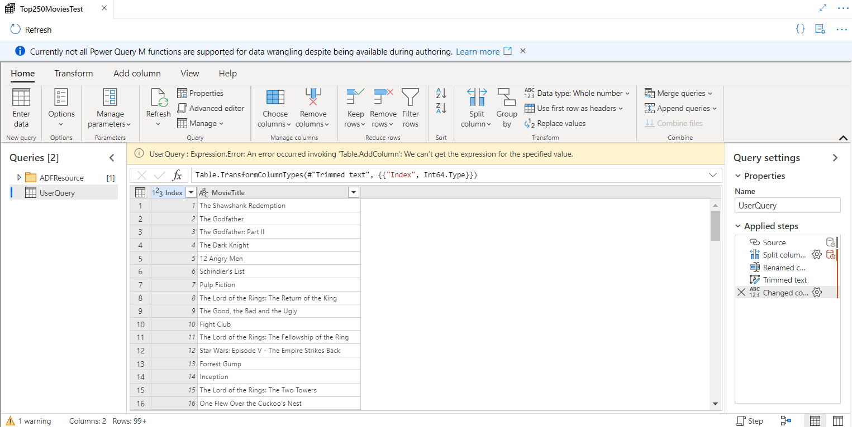
What about ETL?
There are transformation options in ADF
Which we can ignore ☺
Data flows (aka mapping data flow)
Visual layer on top of Spark runtime
Power Query (aka wrangling data flow)
Like Power BI/Fabric dataflows

Slide 9
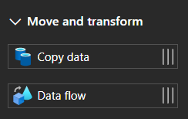
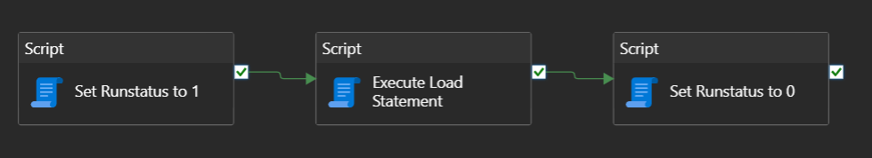
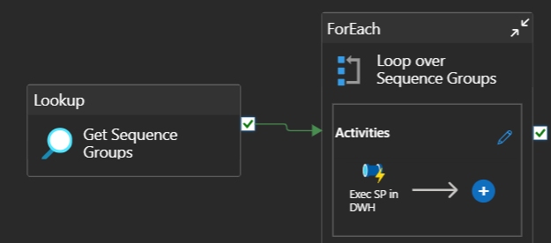
Three types of activity
Data Movement activities
Basically the Copy Data activity
Data is copied using Azure compute
External (transformation) activities
Compute is not in ADF
E.g. stored procedure, Pig Script, Databricks Notebook, Azure Function …
Pipeline (control flow) activities
Lightweight “internal” activities
E.g. Lookup, Set Variable, For Each, If condition …

Slide 10
ADF vs SSIS

Slide 11
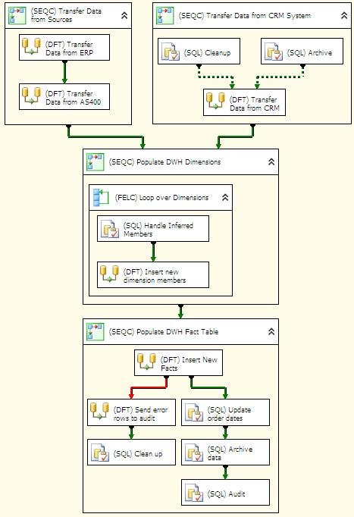
pipeline = control flow

Slide 12
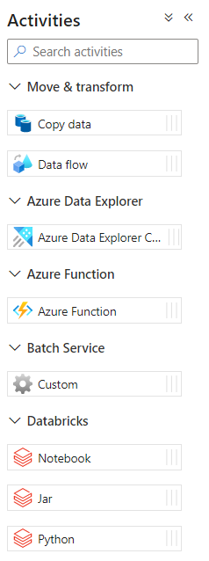
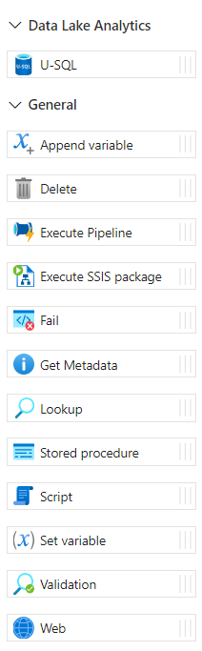
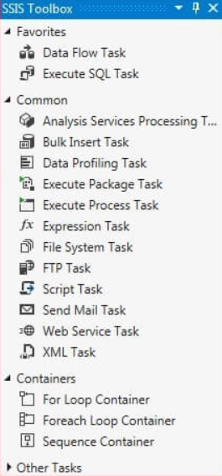
activities = control flow tasks

Slide 13

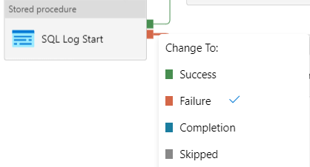
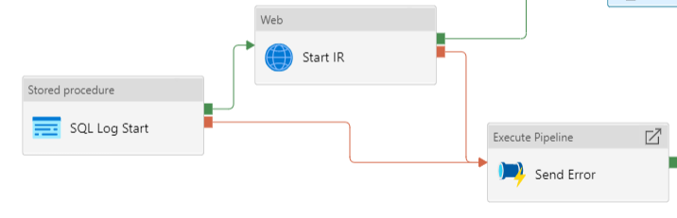
precedence constraints?

Slide 14
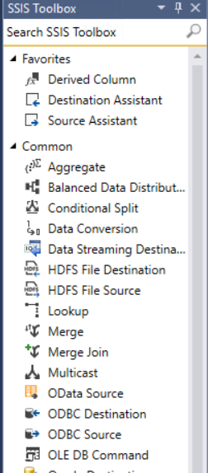
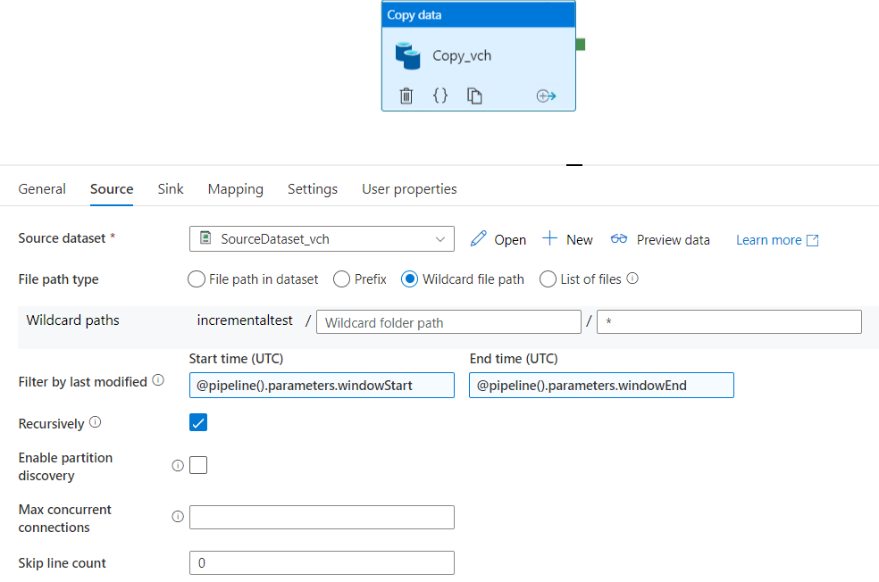
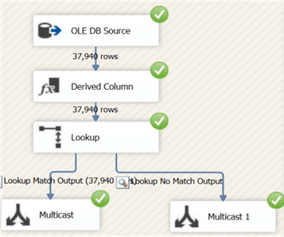
copy data activity = data flow with only source and destination

Slide 15
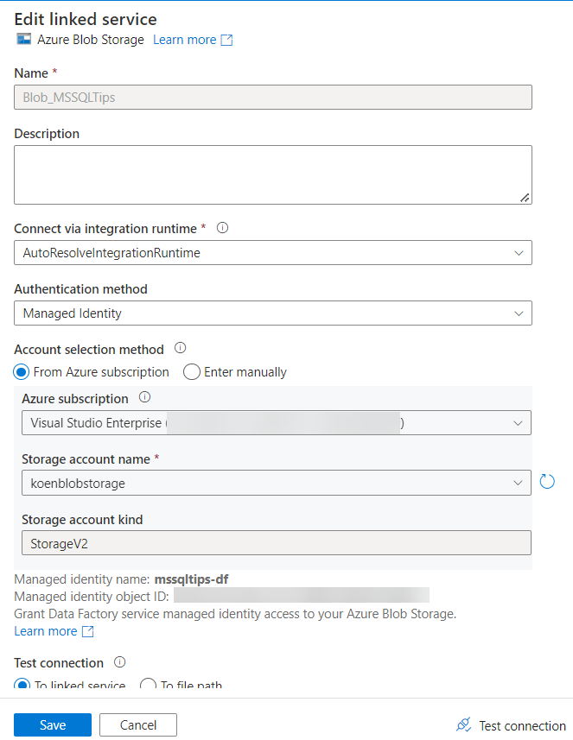
linked service = connection manager
points to a certain data location
contains info on how to authenticate
can integrate with Azure Key Vault

Slide 16
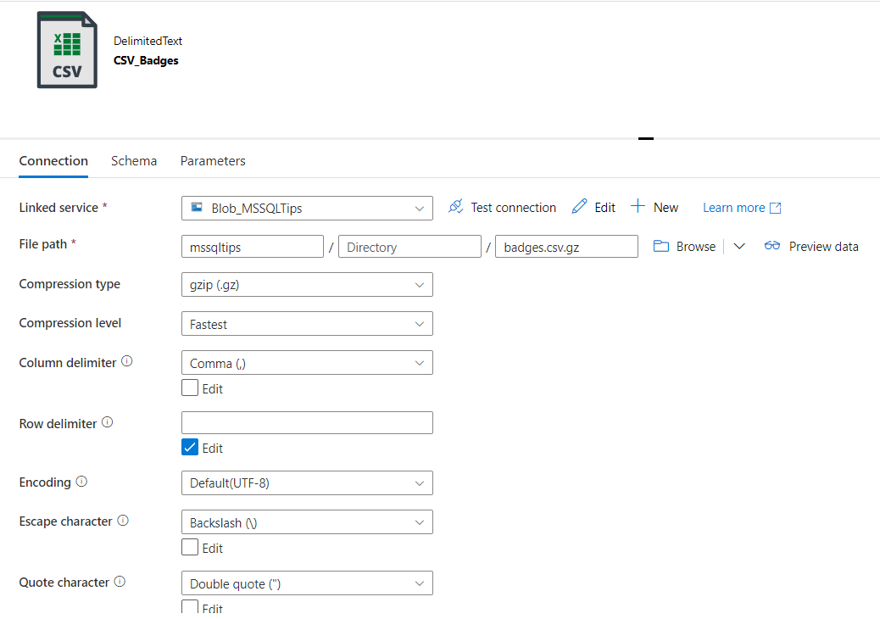
data set

Slide 17

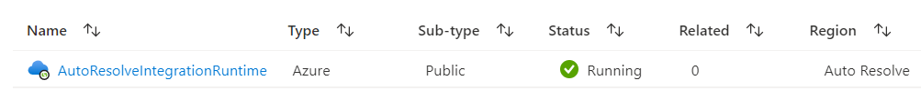


integration runtimes

Slide 18
SSIS vs ADF
SSIS is on-premises
many up-front costs
server
license costs
cost of installing / configuring
not many running costs
maintenance
development
“electricity”
it doesn’t matter how many packages you run
or how many tasks there are in a package
ADF is in the cloud
SaaS: no up-front costs
maybe self-hosted IR
no license costs
many running costs
compute cost per minute
development
# of activities has significant impact
and how long they run

Slide 19
How to save on costs

Slide 20
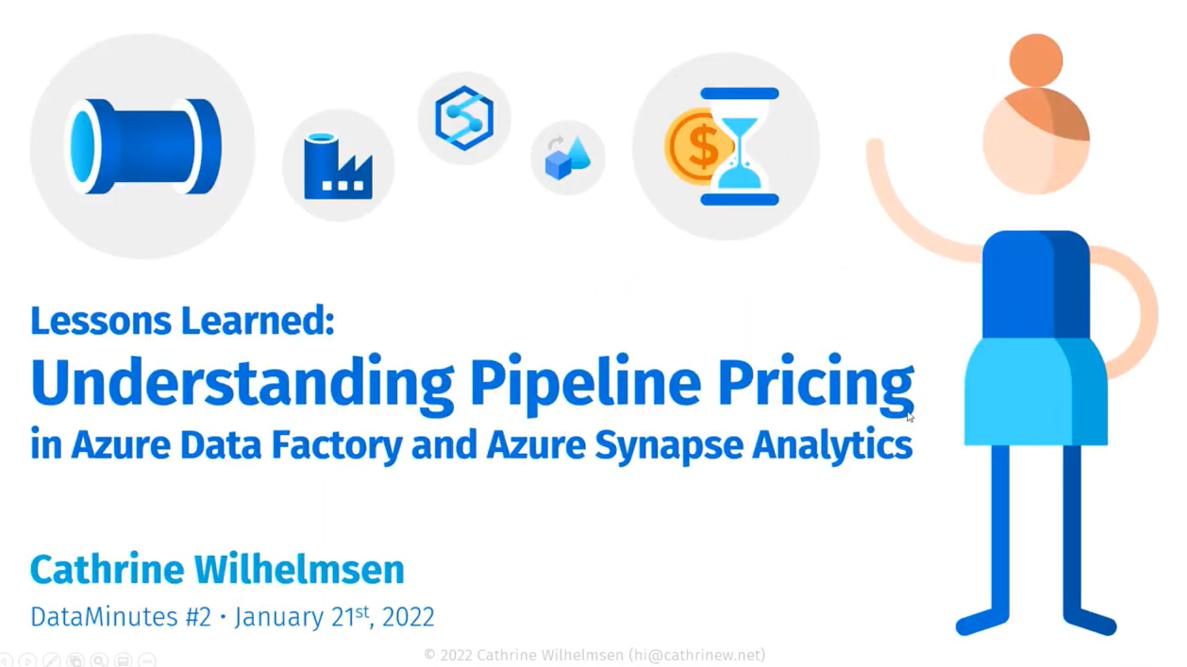
costs in ADF
https://youtube.com/watch?v=Fct1dcZMyWs

Slide 21
important to remember
ALL ACTIVITIES ARE PRO-RATED BY THE MINUTE
AND ROUNDED UP

Slide 22
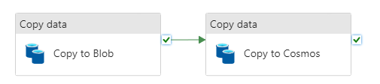
that’s 2 minutes right there

Slide 23
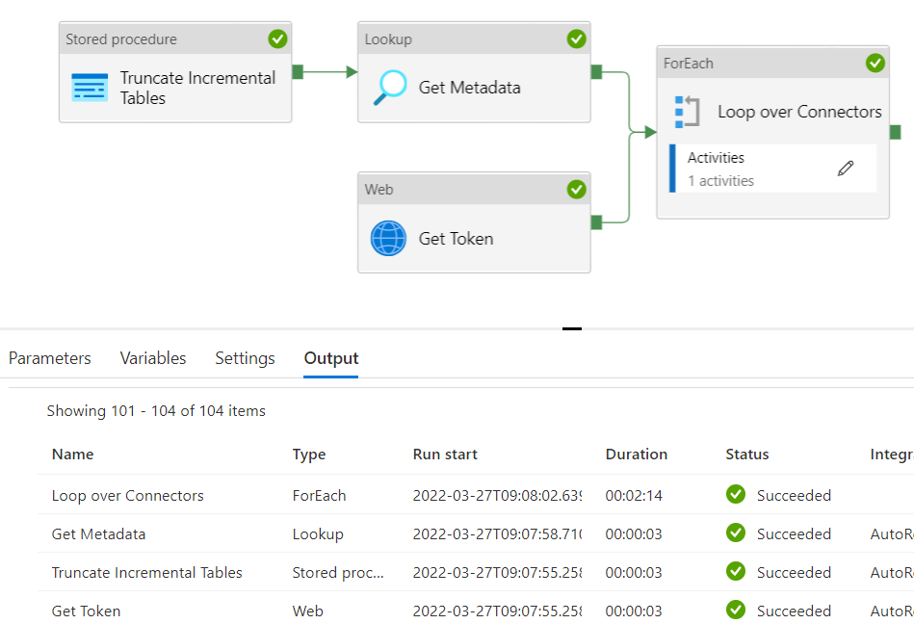
example
2 minutes and 23 seconds runtime

Slide 24
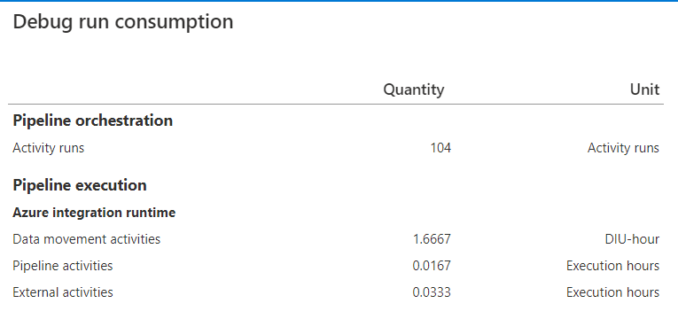
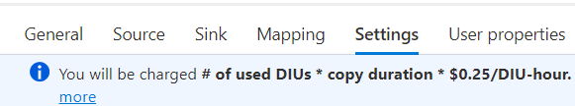
example
Orchestration (Azure-IR): $0.001/run
Pipeline (Azure-IR): $0.005/hour
$0,0000835/run
External (Azure-IR): $0.00025/hour
$0,000008325/run
Data Movement (Azure-IR): $0,25/hour
→ 2 * 1.6667 * $0.25 = $0,83335/run
$0,834441825 / run
once every day: $25.03
once every hour: $600.80
once every 5 min: $7209.58
1 minute
100 minutes!
2 minutes

Slide 25
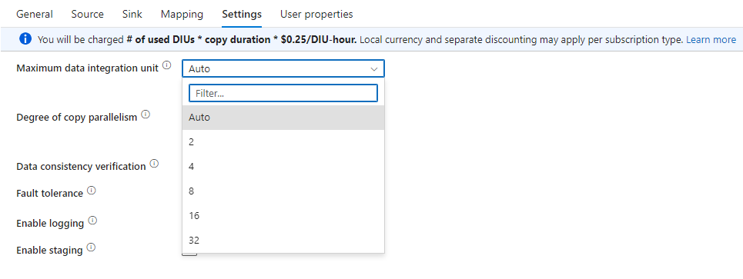
50% cost saving with one single config

Slide 26
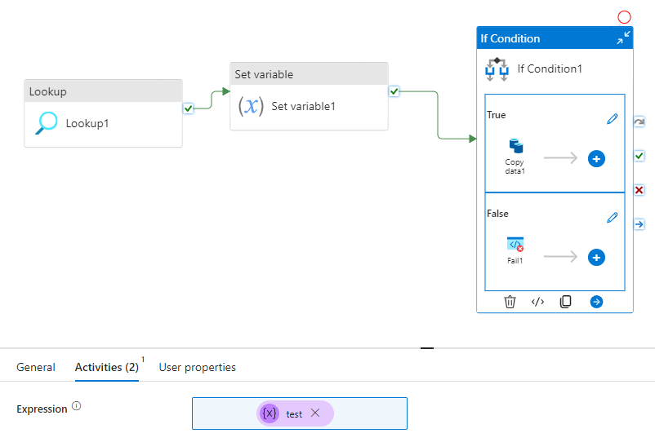

minimize number of activities
directly refer to lookup output instead

Slide 27
move compute to somewhere else
preferably to something that doesn’t have “pricing per minute”
write SQL in the DB, e.g. Azure SQL DB
scale up before ELT
scale down once ELT is done
or to compute that is just cheaper
Azure Functions or Azure Logic Apps are good alternatives
for smaller workloads
for bigger workloads, maybe consider using a self-hosted IR in a VM

Slide 28
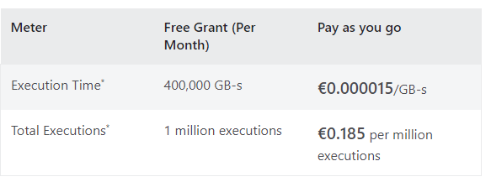
Azure Functions
CAUTION!
don’t forget your dev costs

Slide 29
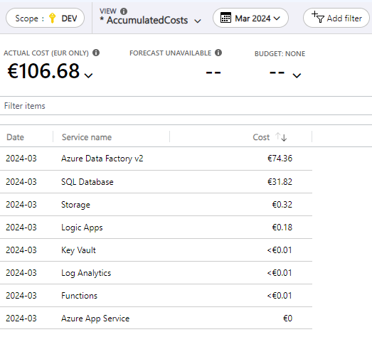
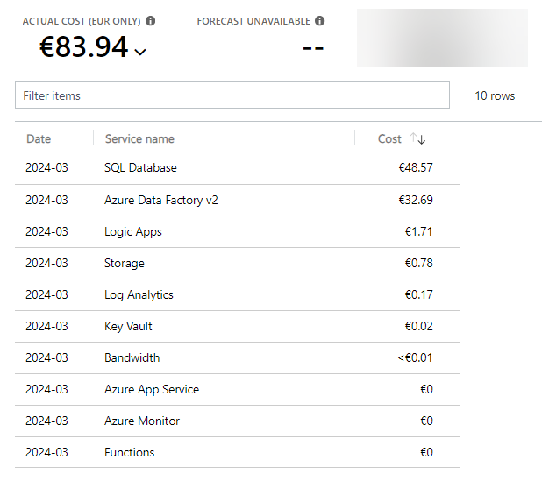

Slide 30

Dataflows?
If you already have the data in a database …
… you are paying twice for compute

Slide 31
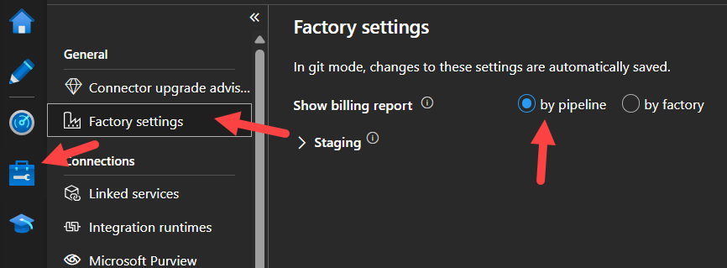
Get insights in costs
Azure Cost Analysis
Or your billing report

Slide 32
What about Fabric?

Slide 33
Fabric uses CU consumption
Only two types of activities:
Data movement – 1,5 CU hours
Data orchestration – 0,0056 CU hours per activity run
In docs, 1 CU hour = $0,18
Copying 1TB of data to a warehouse
Takes about 11 minutes (662 seconds)
“intelligent throughput optimization” was 4
Utilized CU hours = 4 * 1,5 * (11/60) = 1,1 CU hours (or 3960 CU seconds)
1,1 CU hours * ($0,18 / CU hours) = $0,20
Check out the pricing examples (they are misleading though as they deal with only 1 copy activity)

Slide 34
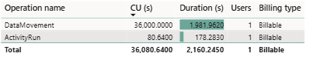
ADF vs Fabric
In ADF, duration matters for all activities
In Fabric, duration only matters for copy data activity
Cost of the same pipeline
ADF = $0,83335 per run (with default settings: $1,66 per run)
Fabric = 36000 CUs = 10 CU hour => 10 CU hour / (4 * 1,5) = 1,666667 hours (same as in ADF, thus 100 minutes) => 10 CU hour * ($0,18/CU hour) = $1,8 per run
Fabric is about 8% more expensive (keep in mind you pay for the capacity running)

Slide 35
conclusion

Slide 36
conclusion
ADF is not a streaming service
you pay for each activity at least one minute
copy activity is the most expensive one
try to avoid managed VNET integration if it is not really needed
move compute to external options
Azure Functions & Logic Apps
Databricks / SQL Server
running ADF yourself on a self-hosted IR might be cheaper
Fabric is about 8% more expensive
if you get ADF to be really cheap, you’re the most expensive part now ☺

Slide 37

thank
you

